Slide 1
EDA Report
Elaine Wang, Emily Wilkins, Gabriel James, Logan Liu

Slide 2
Agenda
Establish mutual understanding of data
Understand tag distributions for English articles
Highlight potential roadblocks to model development
Identify next steps for Dell and Capstone teams
Notes:
Distribution for Chinese

Slide 3
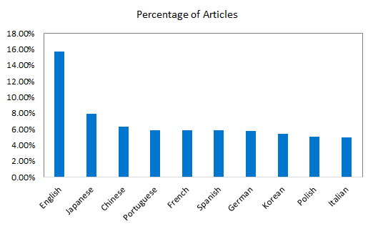
eServices Articles by Language
116,310 total articles
18,302 English articles (15.7%)
7,299 Chinese articles (6.28%)
6,772 German articles (5.82%)
Project will focus on English articles first, then extend to Chinese and German¹.
Ideally, we will establish the groundwork for generalizing predictive models to all languages.
1. These are the languages with which we are most familiar.

Slide 4
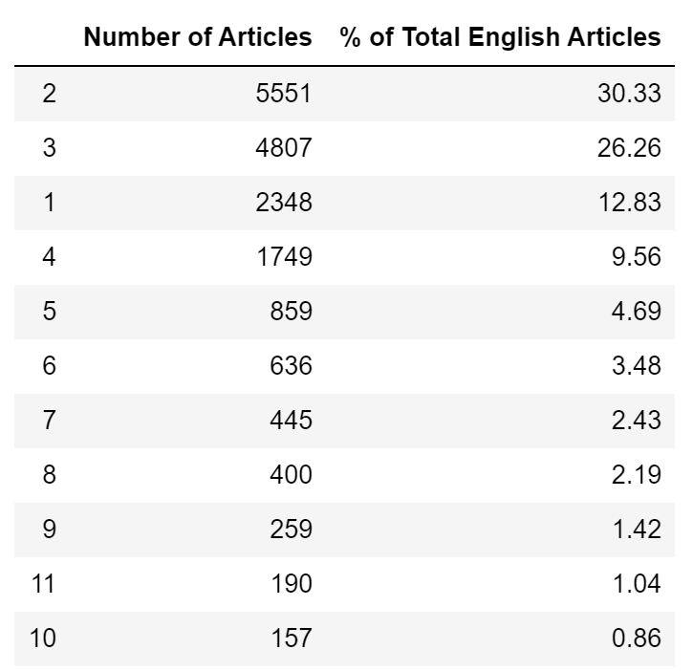
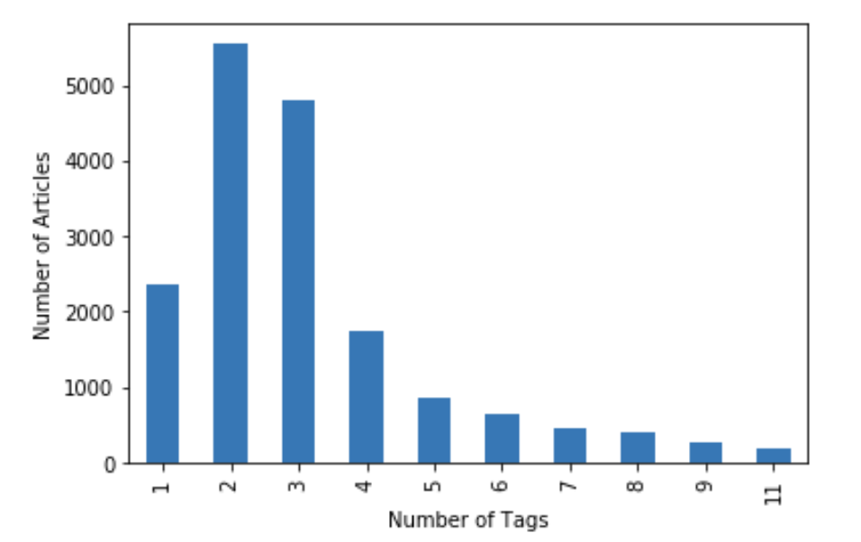
Tag Distribution - English
Quick summary:
Minimum: 1
Maximum: 282
Mean: 4.347
Most articles have fewer than 10 tags.
More than 50% of articles have 2 or 3 tags

Slide 5
Tag Distribution - English
Unique Tags: 2,987
Tags that only occur once: 767
Tags that occur at least 10 times: 1,071
806 Article IDs missing actual article

Slide 6
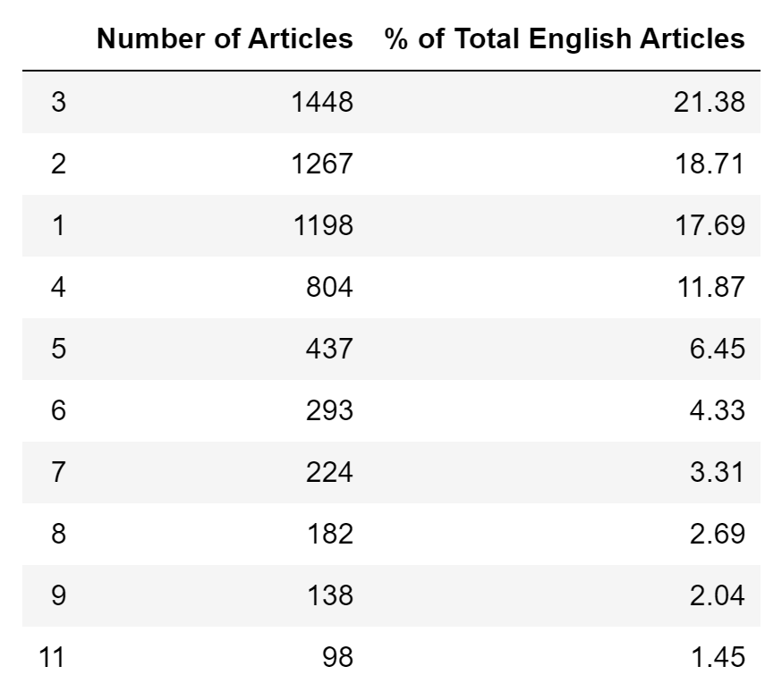
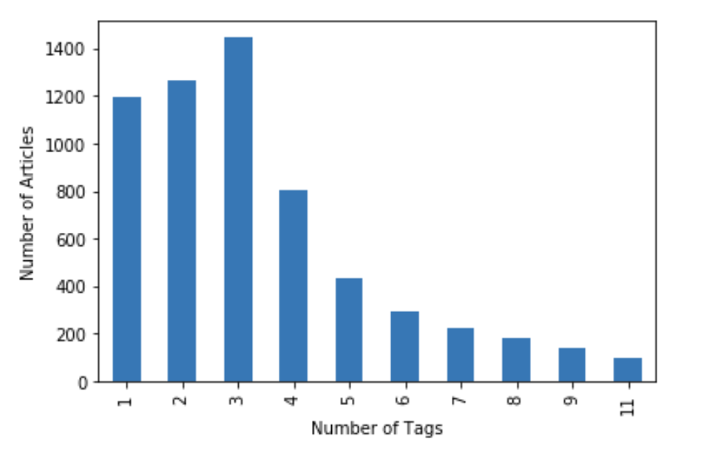
Tag Distribution - German
Number of Articles % of Total German Articles
Quick summary:
Minimum: 1
Maximum: 353
Mean: 5.801
Most articles have fewer than 10 tags.
More than 50% of articles have fewer than 3 tags

Slide 7
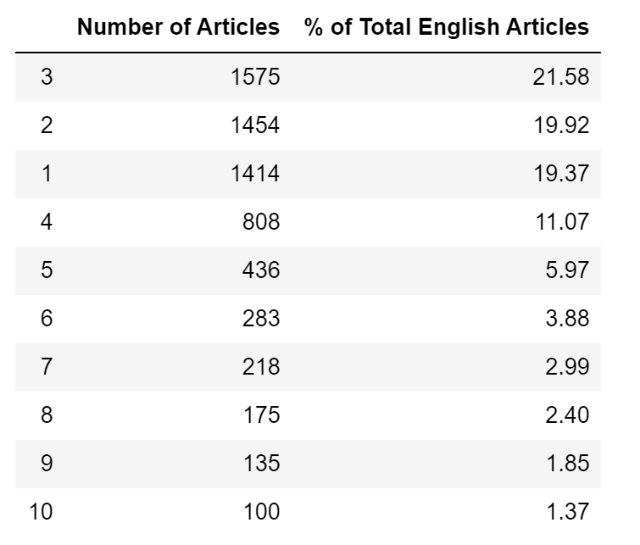
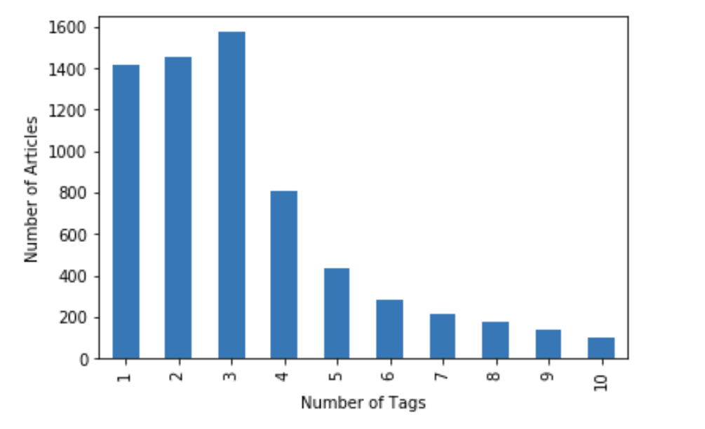
Tag Distribution - Chinese
Number of Articles % of Total Chinese Articles
Quick summary:
Minimum: 1
Maximum: 353
Mean: 5.5069
Most articles have fewer than 10 tags.
More than 50% of articles have fewer than 3 tags

Slide 8
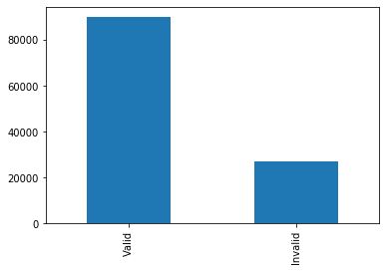
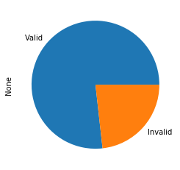
HTML Encoding Error
How many articles are valid/usable in our analysis?
Some article bodies contain long chains of ‘?’s.
Criteria: Articles contain 5 consecutive question marks ‘?’.
Valid: 89,952
Invalid: 27,211
Takeaway:
~23% of articles in XML have unreadable bodies

Slide 9
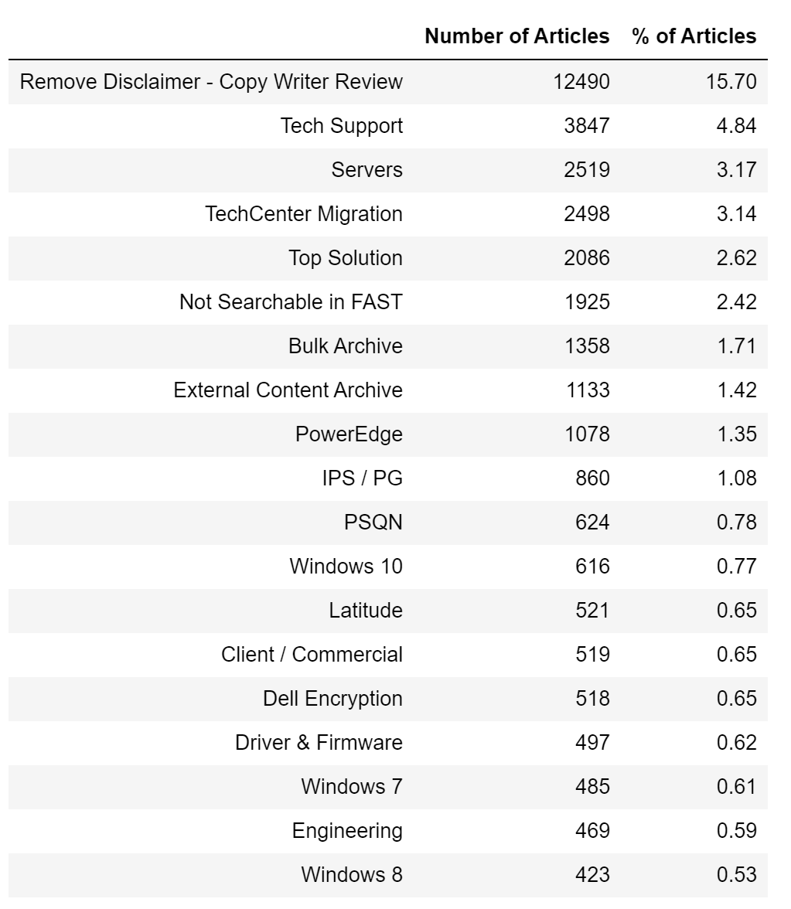
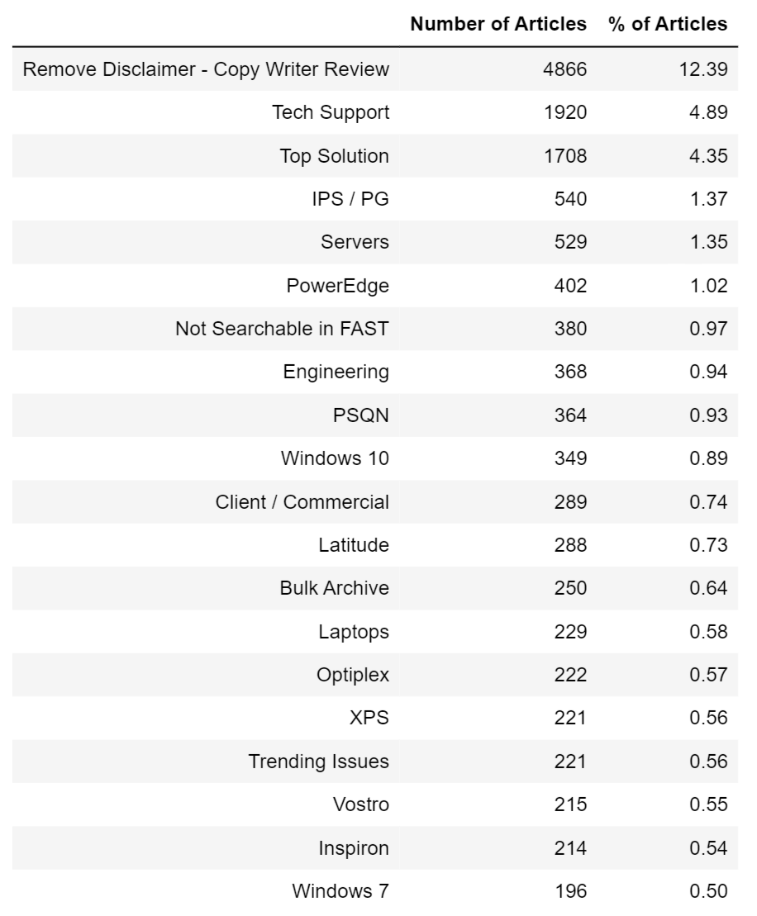
Common Tags
English Tags
German Tags
Notes:
If we can build compatible pipelines for each language, we may be able to circumvent low count tags.

Slide 10
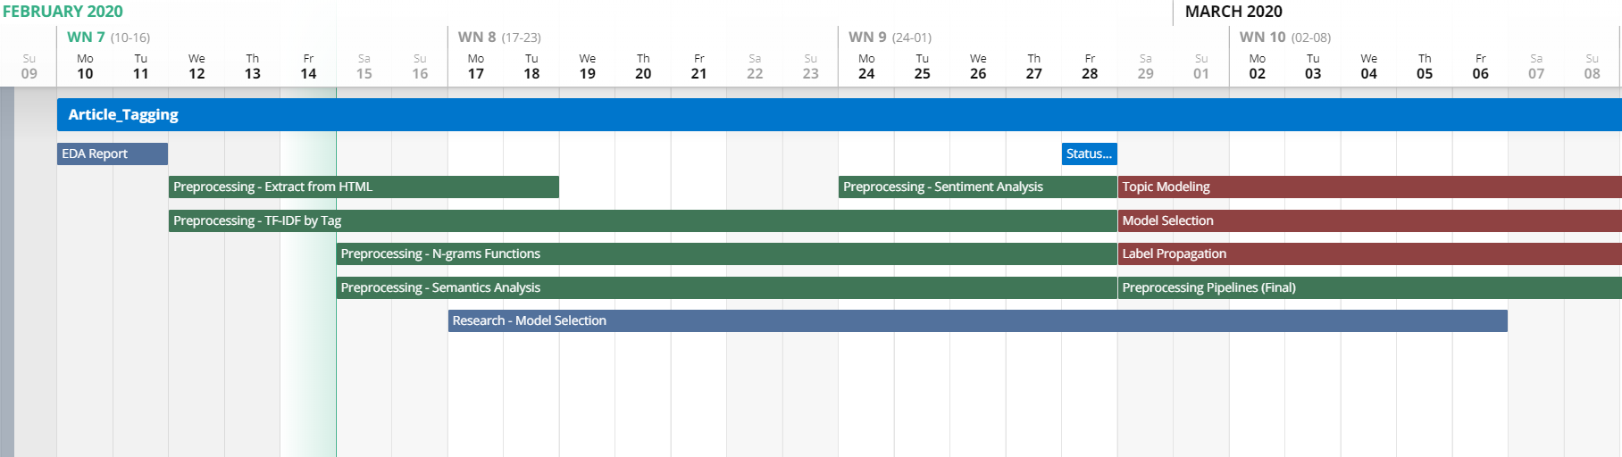
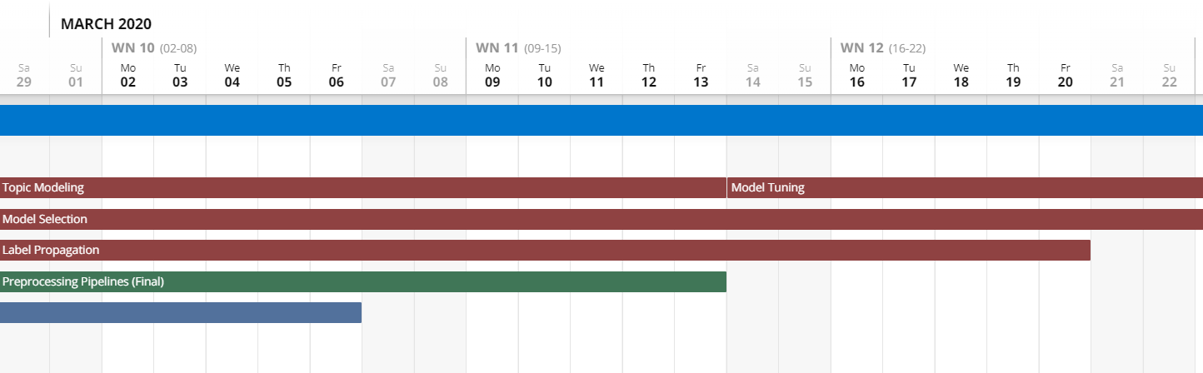
Proposed Schedule

Slide 11

Extracted Title from HTML

Slide 12

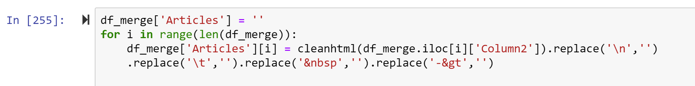
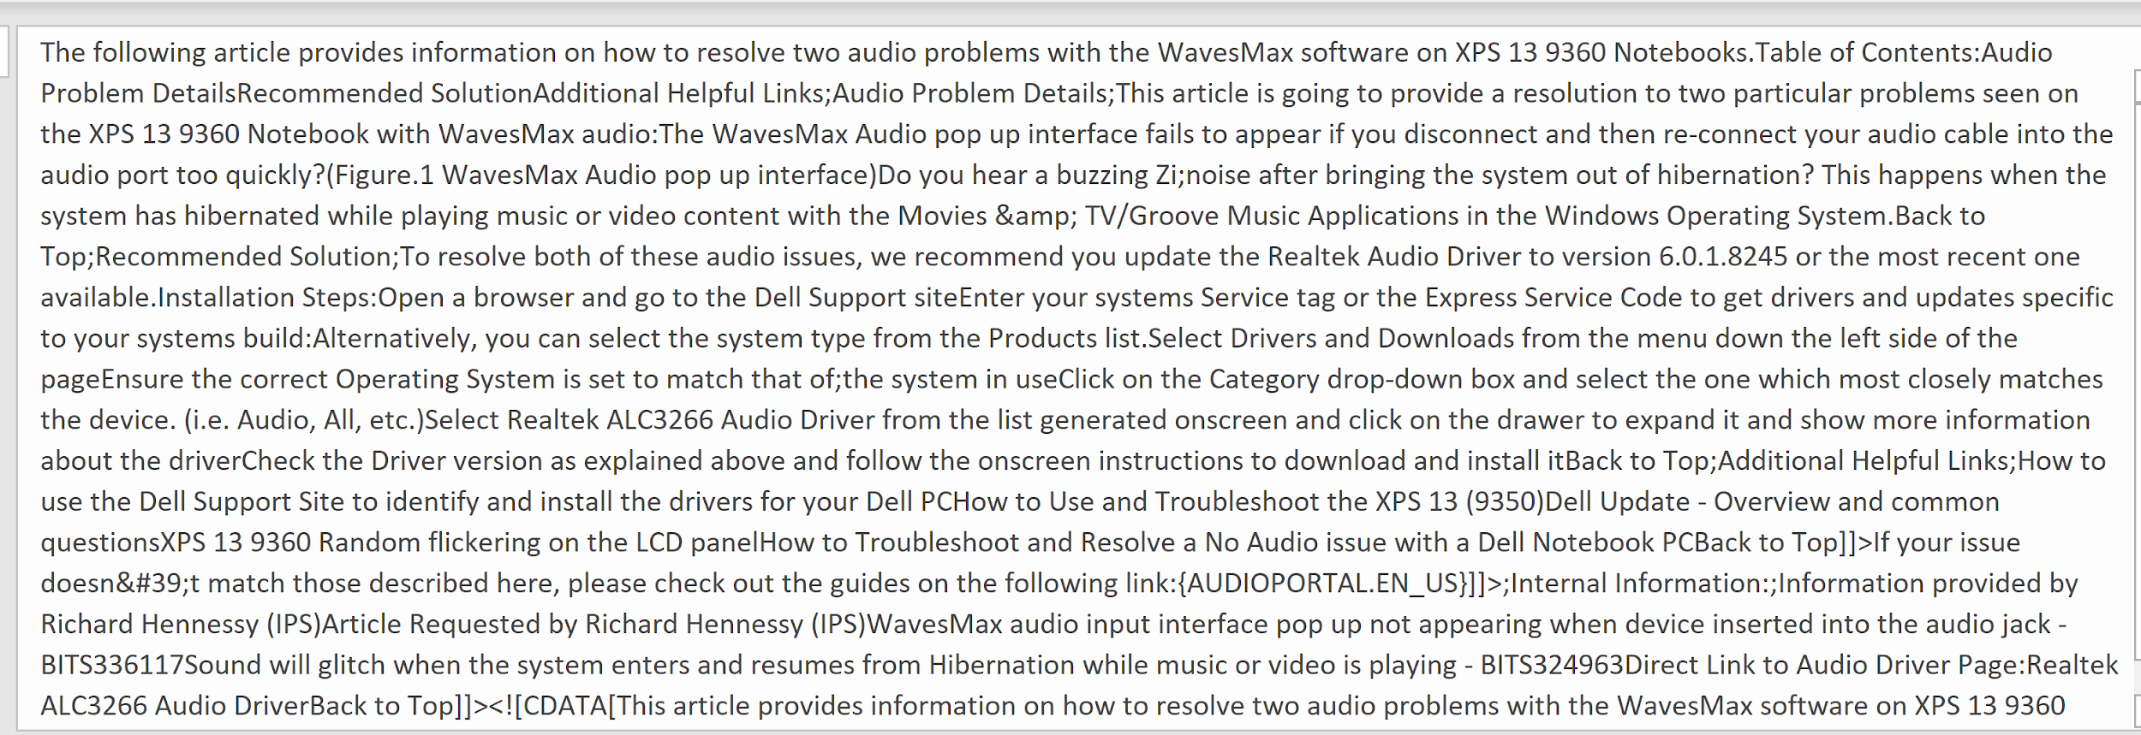
Extracted Article from HTML

Slide 13
Next Steps
Continue with preprocessing efforts
Establish metric to evaluate model (Hamming loss or Exact Match)
Incorporate feedback into scheduling and preprocessing strategy

